Slide 1
TRAVEL
PROJECT BY
G. Ajay Kumar
U.Yasaswini
Varshith Reddy
Deepak

Slide 2
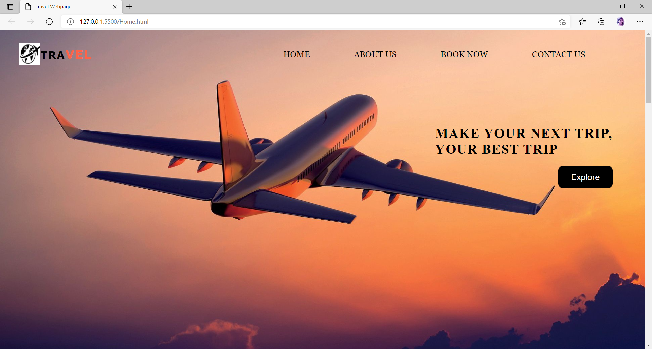
HOME PAGE
In Home page where we can find about us,Book now and contact us.In book now we have options for flight booking,cabs,buses,hotels and also included bookings for private jets.

Slide 3
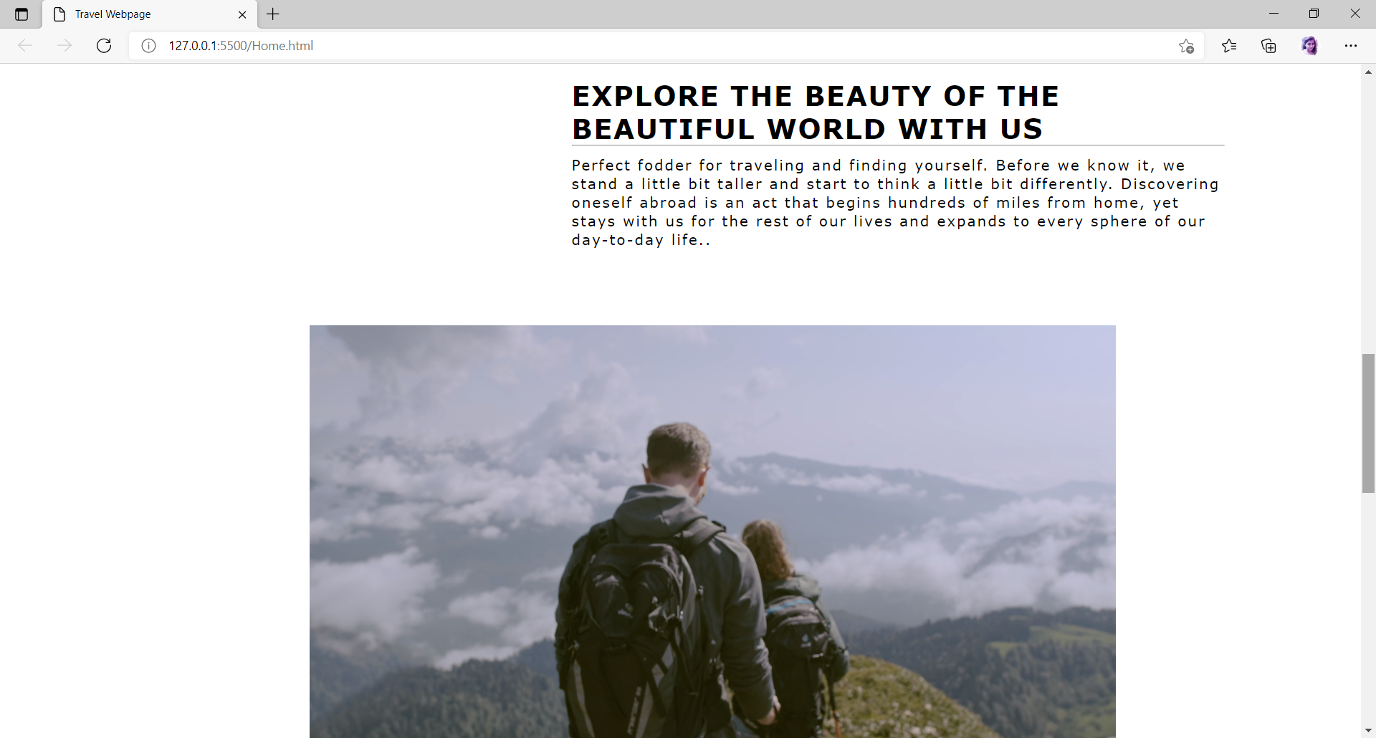
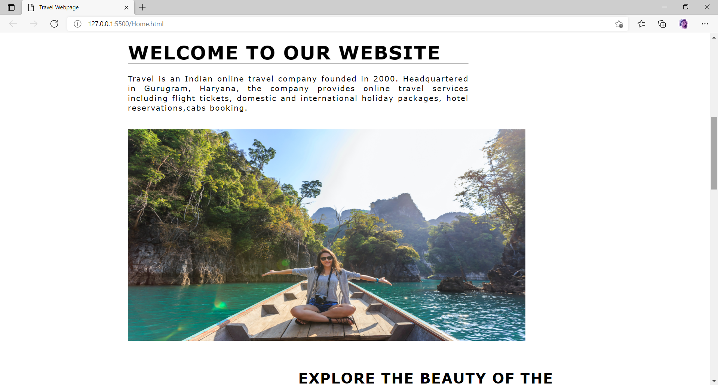
HOME PAGE Continued…

Slide 4
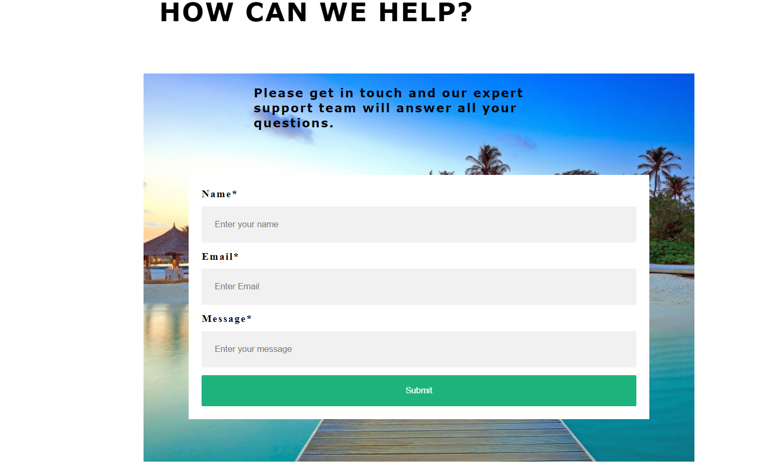
CONTACT US PAGE
In Contact us Page if we are facing any technical issues you just type your name,email ,your message which you are facing and submit the details.

Slide 5
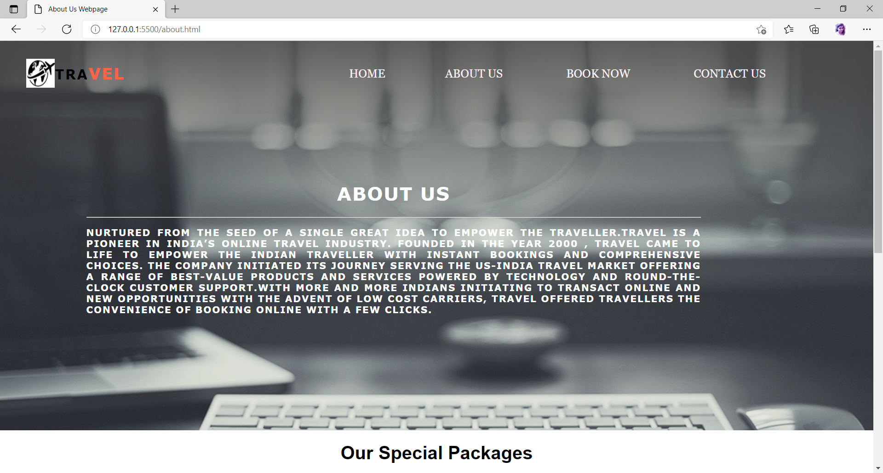
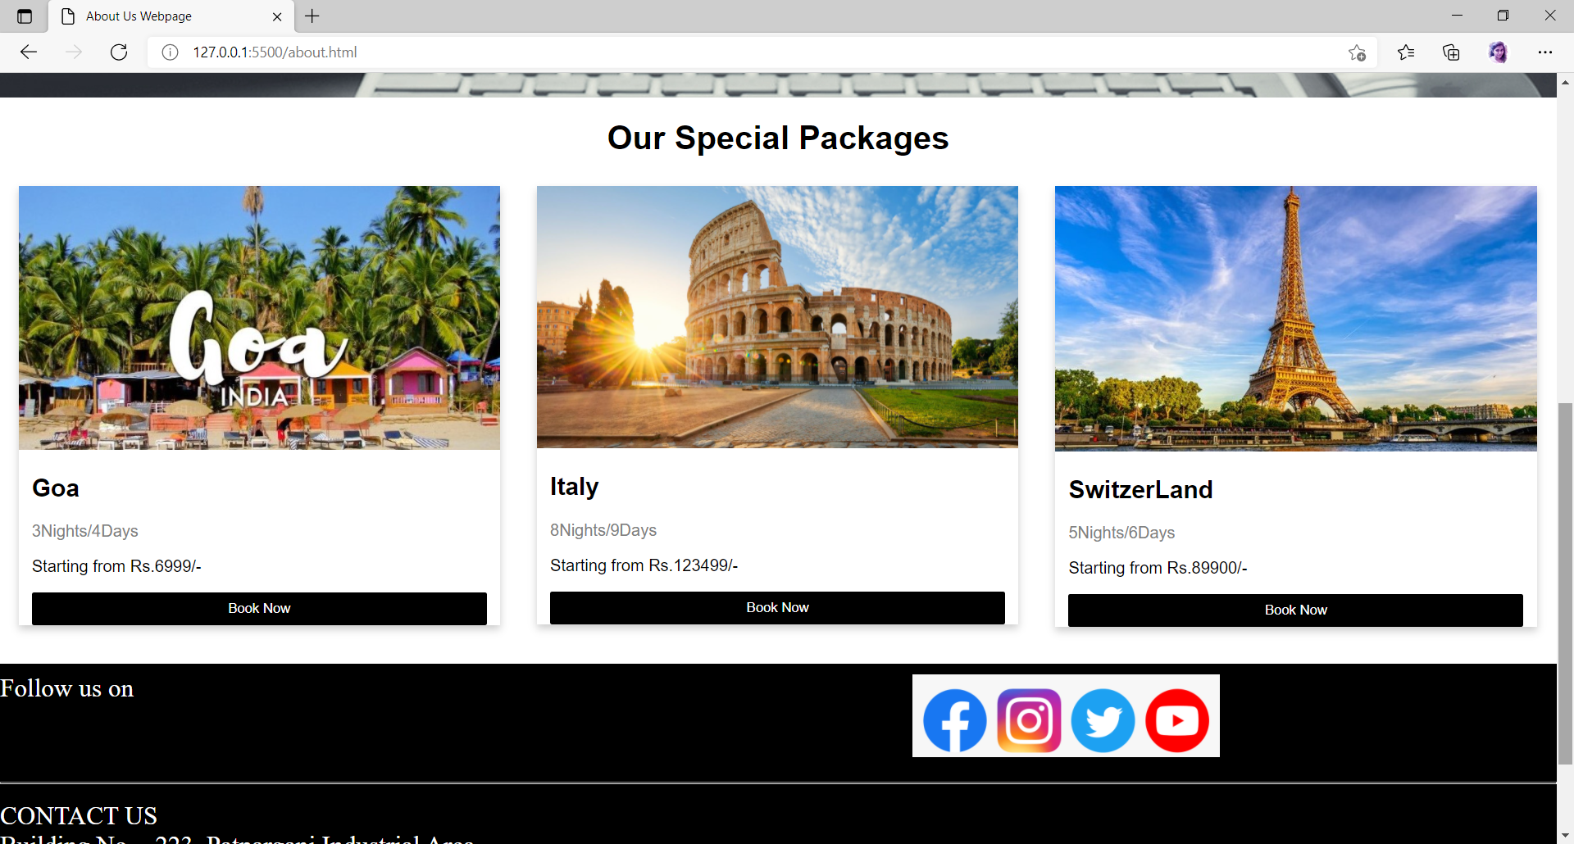
ABOUT US PAGE
You see the special offers that we are offering on most visited tourist places around the globe.

Slide 6
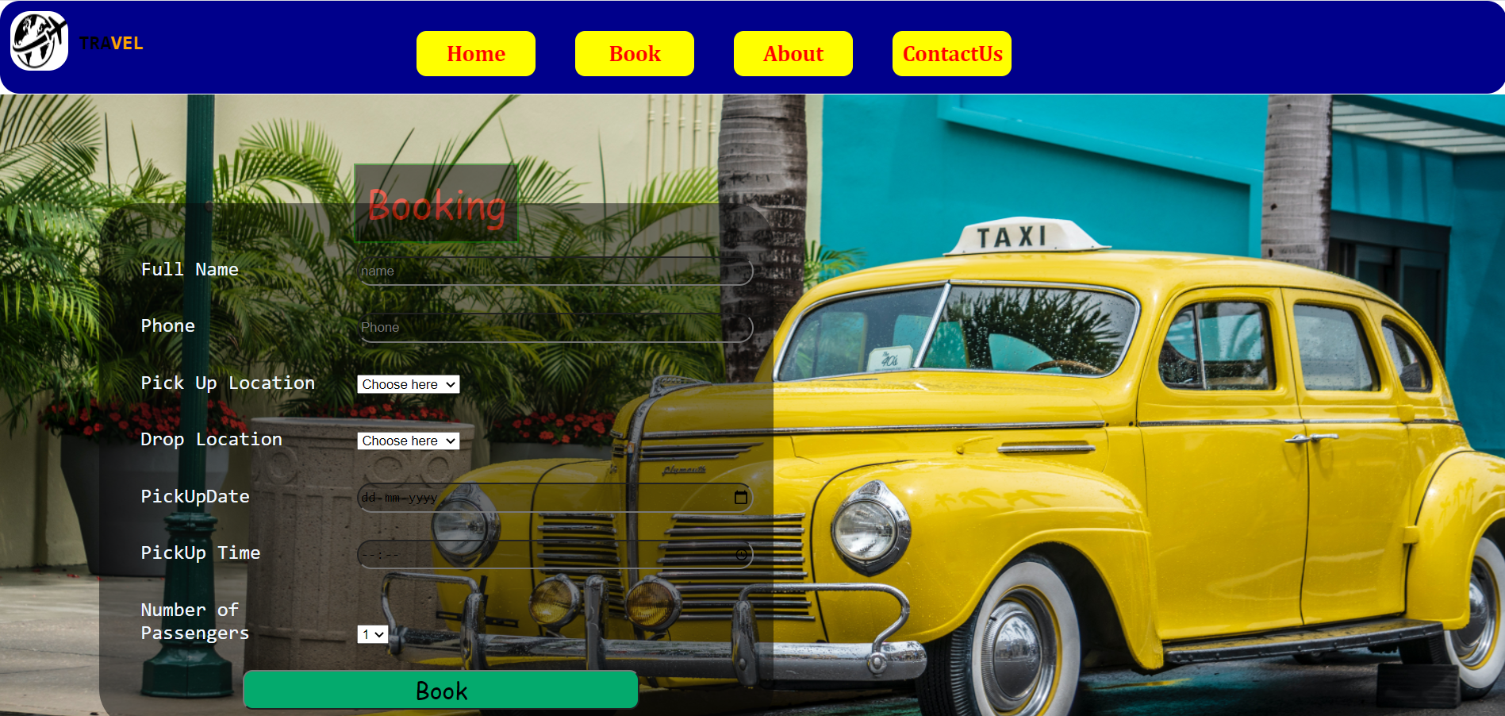
CABS BOOKING
.
Here We Can book our Cab by providing the details of our Journey like Pickup place, Drop location, Check in Date, Check out Date.
We can Navigate to any page of Travel website by using the navigation bar at anytime.

Slide 7
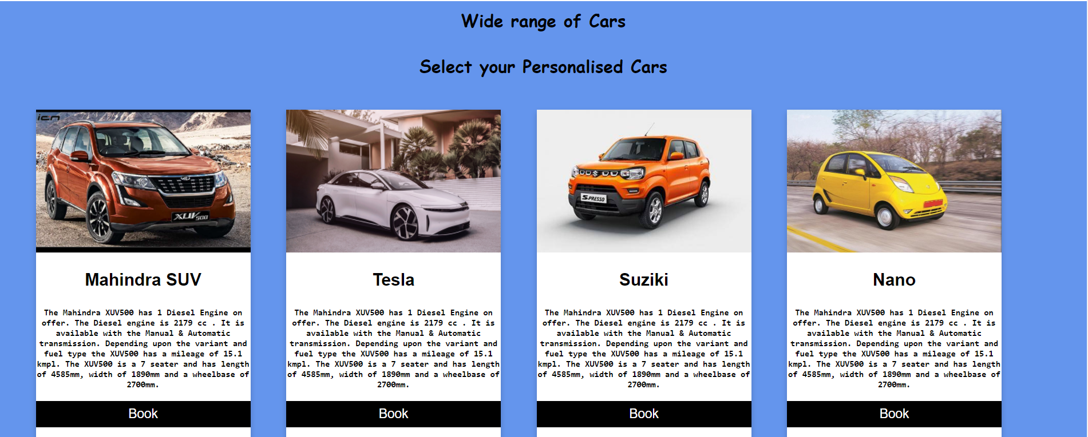
CABS BOOKING
You can get your Personalised tailored Cars on the Website. You can check reviews and specifications of the cars and you can select the Car.

Slide 8
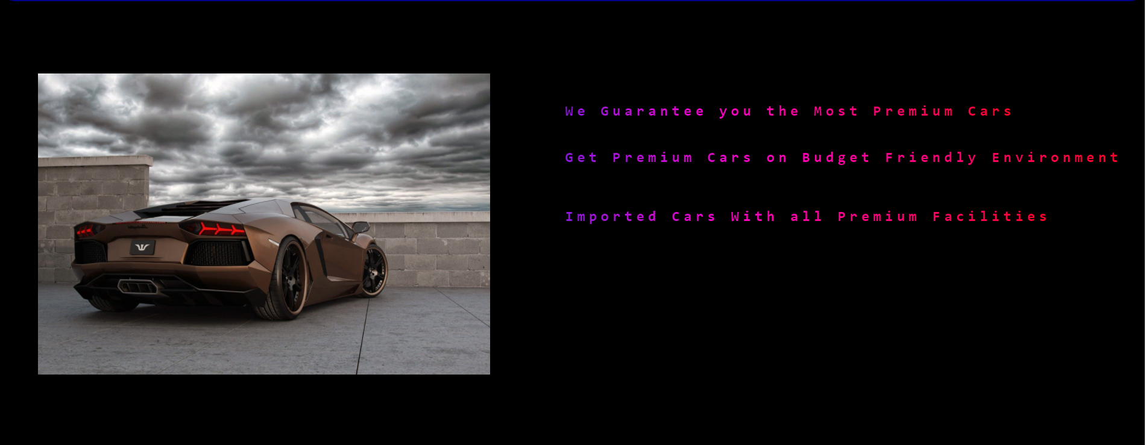
CABS BOOKING
You can even have Premium Car which will have all Comforts in our TRAVEL website.

Slide 9
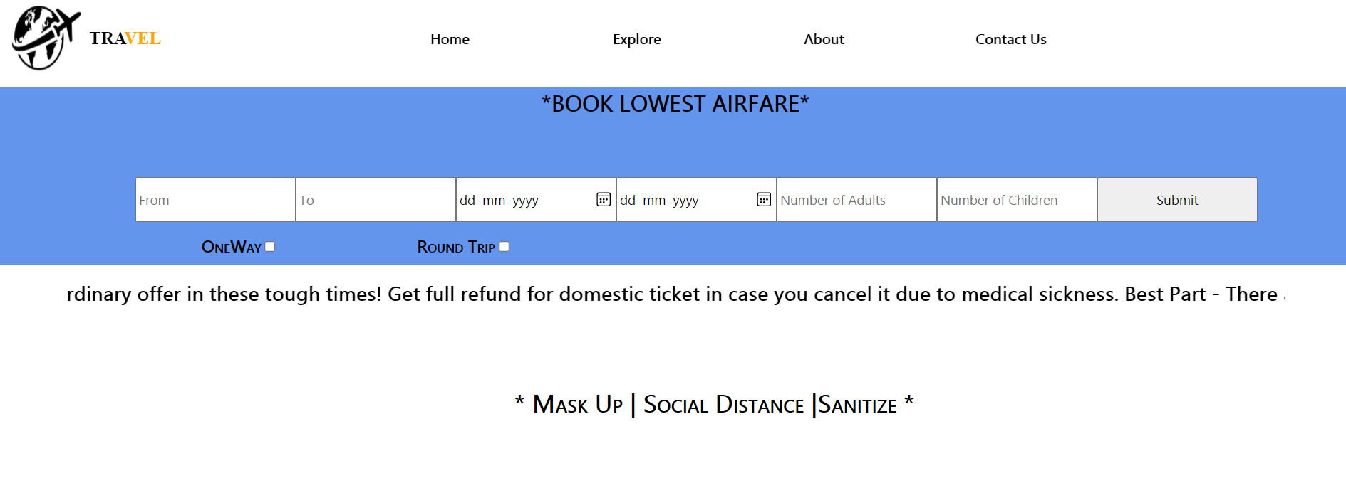
FLIGHTS
Flight Ticket booking can be done here by entering the required details.
The Navigation bar also be present where we can Re-Direct or Navigate to Home Page and Other Pages.

Slide 10
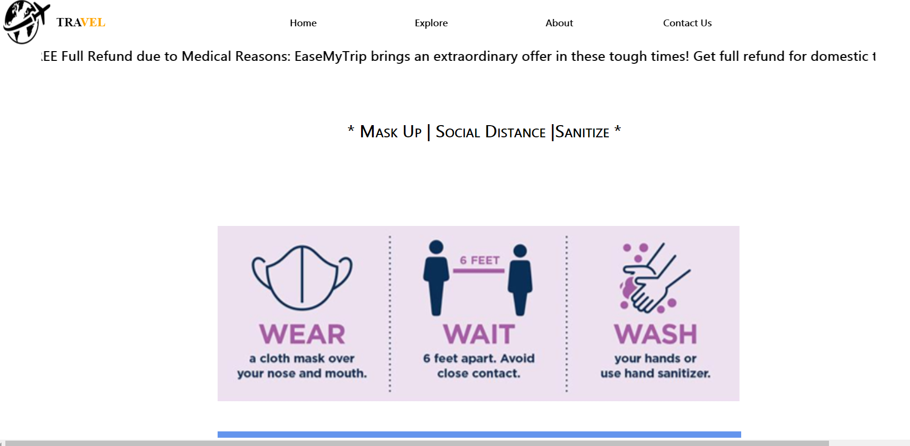
Precautions

Slide 11
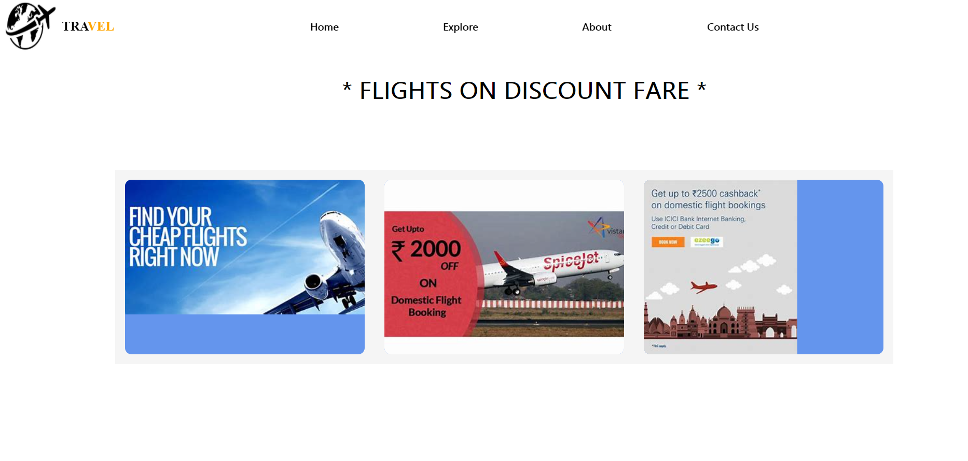
Flights at Cheapest Fare

Slide 12
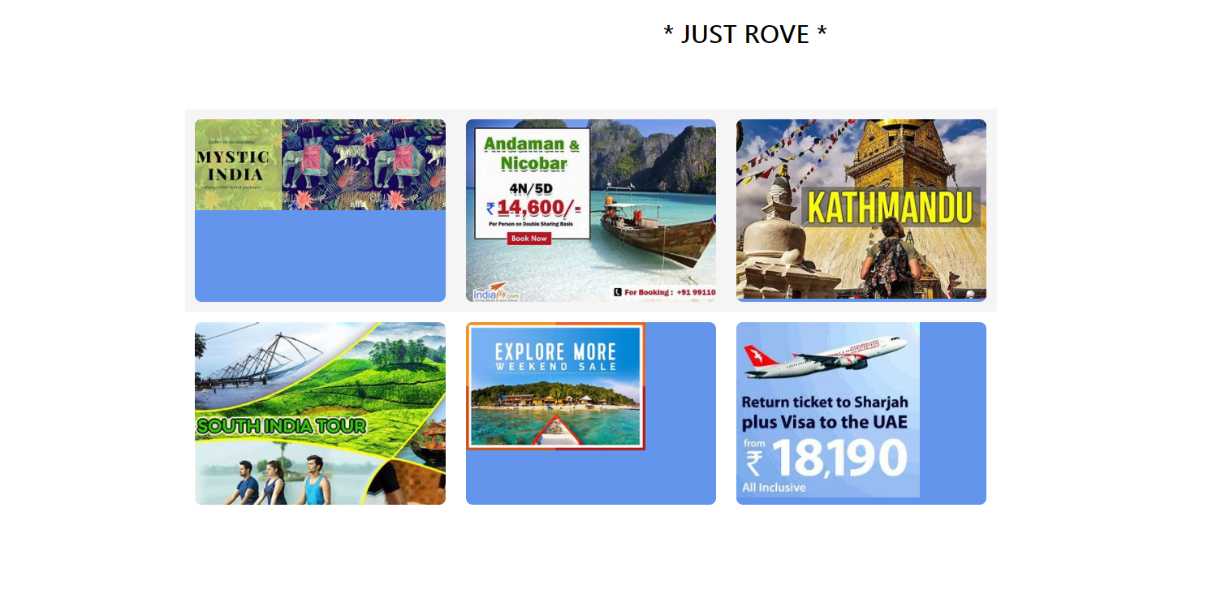
Just Travel Round With Our Packages.

Slide 13
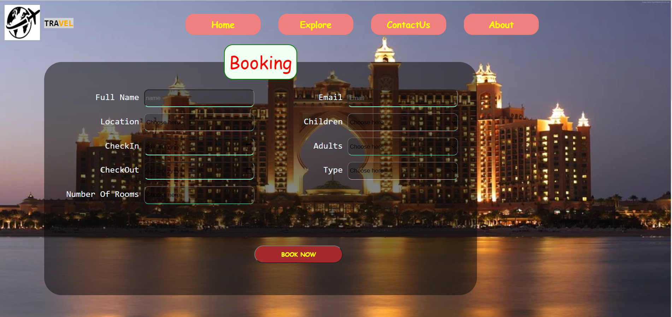
Hotels
Here We Can book our Hotel Room by providing the details of our Journey like Check in Date, Check out Date, Required Rooms, Number of adults and children.
We can Navigate to any page of Travel website by using the navigation bar at anytime.

Slide 14
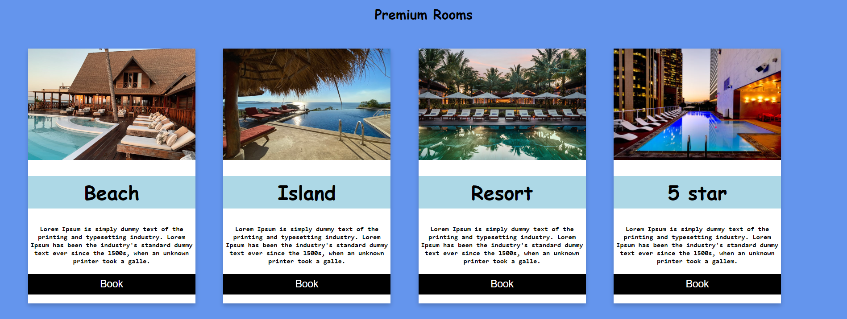
Hotels
We can book Resorts for family gatherings, beach houses, 5 start hotels rooms and any more by seeing their offerings on the website.

Slide 15
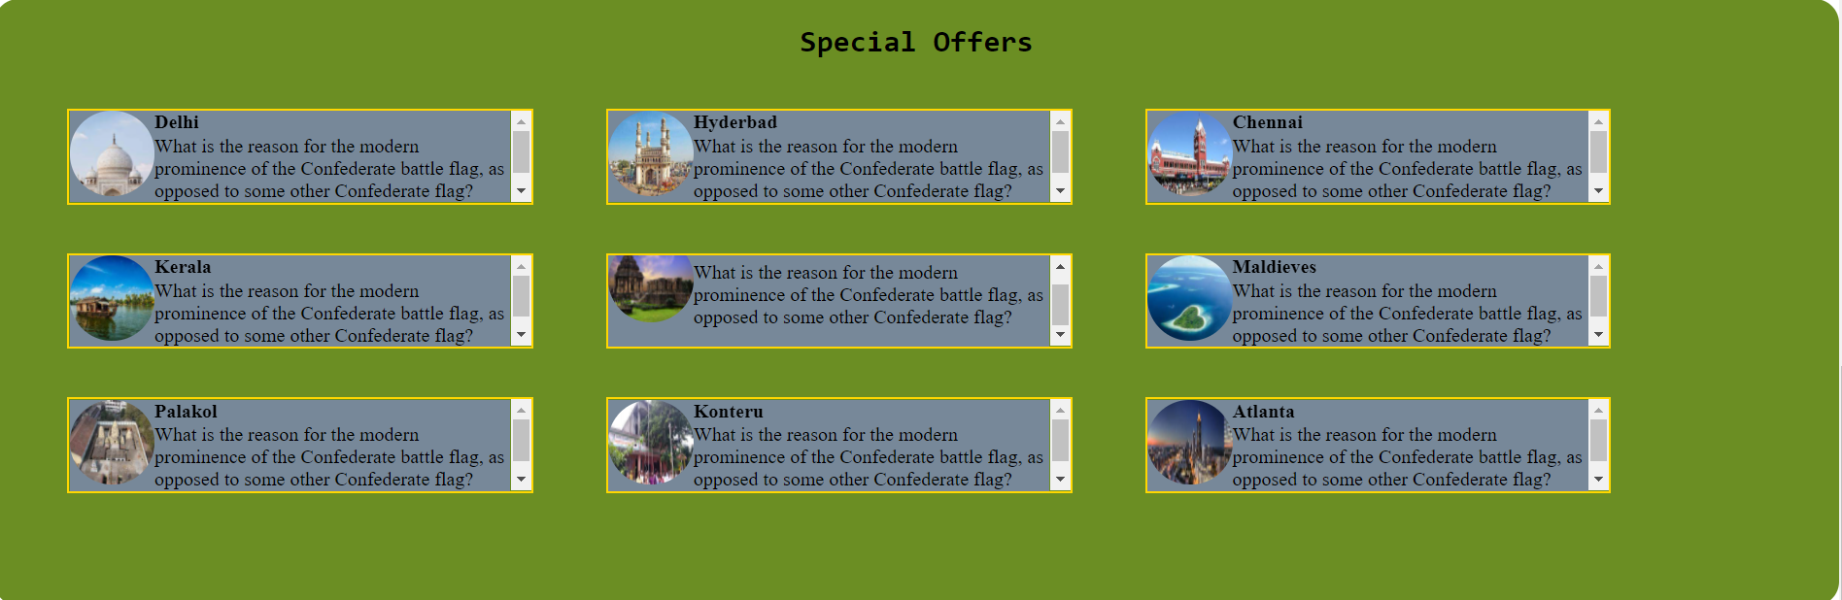
Hotels
You see the special offers that we are offering on most visited tourist places around the globe.
You can have glance about the offers which may assist you in taking your decisions.

Slide 16
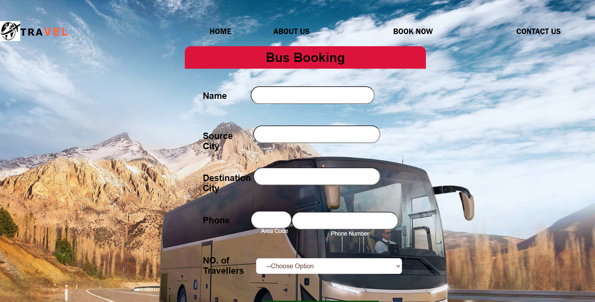
BUS BOOKING
Here We Can book our buses by providing the details of our Journey like source city, Destination city, Check in Date, No. of travellers.

Slide 17
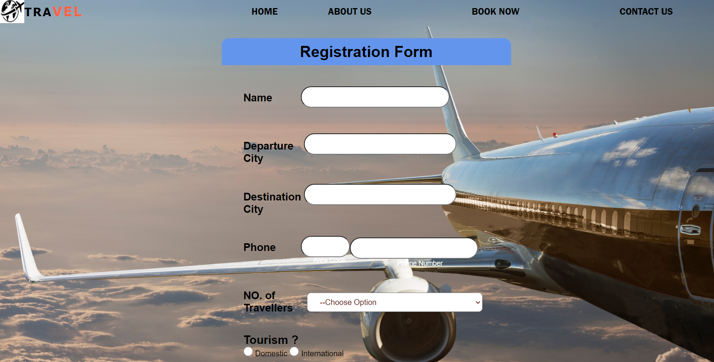
CHARTERS BOOKING
Here We Can book our flights by providing the details of our Journey like Departure city, Destination city, No. of Travellers.

Slide 18
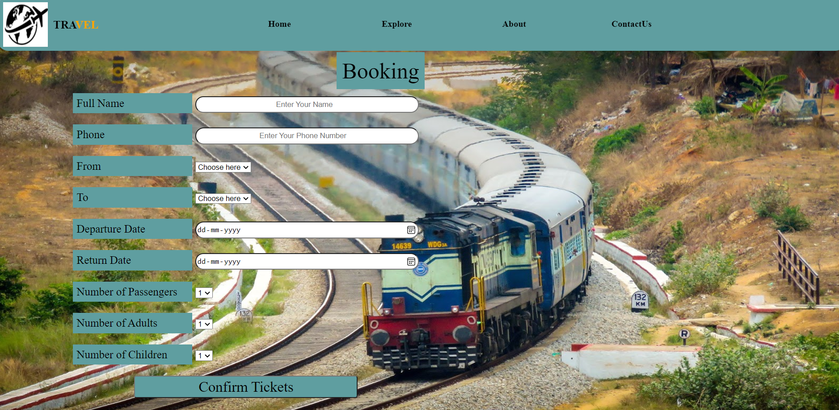
Train Booking.
- We can Book Train Tickets here by providing certain required details.

Slide 19
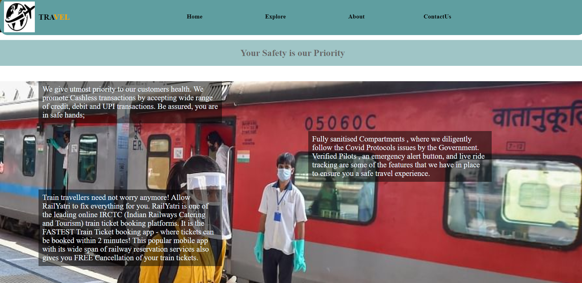
Important Content

Slide 20
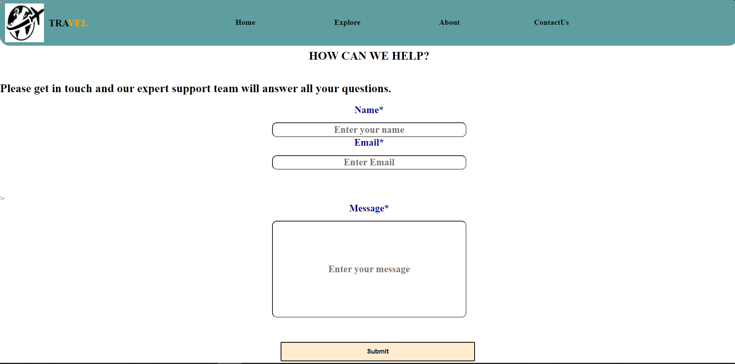
Customer Service

Slide 21
THANK YOU

